Slide 1
DEF/LEF to SVG
Ahmed Sharaf-ElDein
Ahmed Marzouk
Alaa Mohamed
Ahmed Fayed

Slide 2
Problem
- Convert a routed design in DEF and LEF to a layout in SVG.
- Make it web-based.

Slide 3
File Formats
Input files:
DEF file
LEF file
Output file:
SVG file

Slide 4
Libs/tools used
- svgZoomPan https://github.com/ariutta/svg-pan-zoom
- jquery, JavaScript, HTML, CSS
- DEF and LEF parser https://github.com/claude-abounegm/DEF-Viewer/tree/master/DEFViewer/Scripts/Custom
- Bootstrap

Slide 5
Solution
- Parse the DEF and LEF files.
- Iterate through the parsed DEF object and, using SVG library and the parsed LEF, draw:
Every cell given the dimensions stated in the LEF file and the locations stated on the .def file.
The pins.
The nets.
- Meanwhile: prepare the popover data, search data, and record DRC violations.

Slide 6
Code structure
index.js
SVGlib.js
parser.js
drc.js
svgZoomPan.js

Slide 7
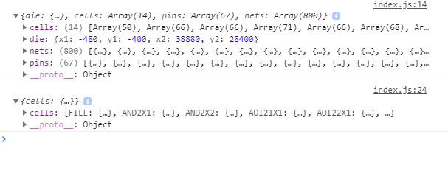
Parsing the DEF and LEF files.

Slide 8
DRC Checking
DRC errors are checked according to the design rules specified by the LEF file
The spacing information is read from the LEF file
The wires are checked iteratively, and the DRC errors are recorded
The recorded DRC errors are drawn

Slide 9
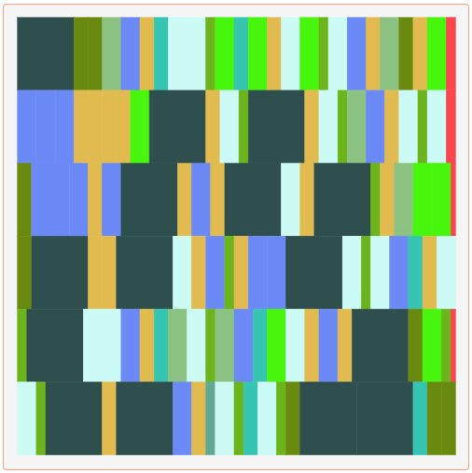
Drawing the cells

Slide 10
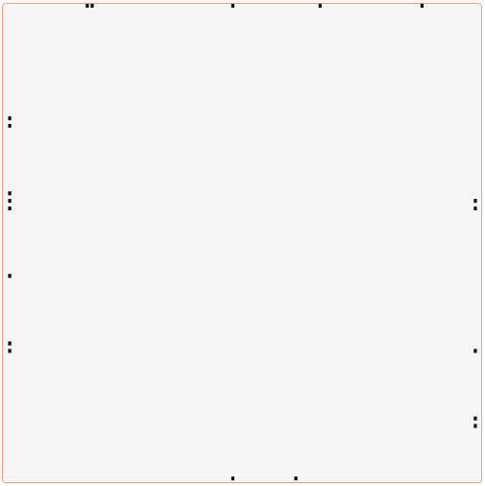
Drawing the pins

Slide 11
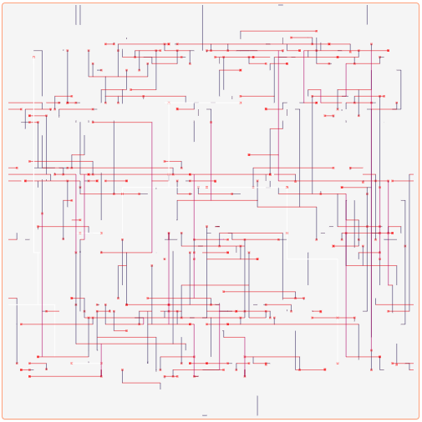
Drawing the Nets

Slide 12
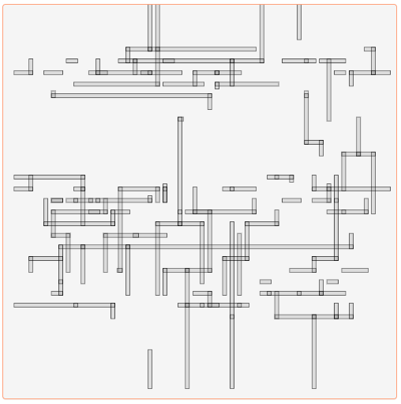
Drawing the DRC Errors

Slide 13
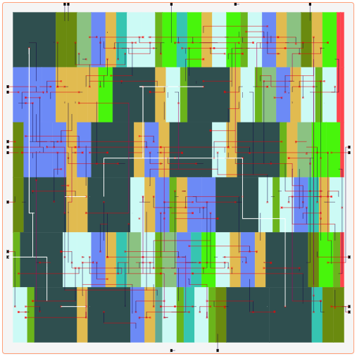
All Together

Slide 14
Design issues
- Some of the features might not be supported on older browsers.

Slide 15
How to build the solution
- just open the index.html file

Slide 16
LIVE DEMO
https://def2svg.000webhostapp.com/

Slide 17
Remaining work
- Checking the DRC errors for the Vias
- Improving the UI colors
- Testing the compatibility on different browsers
- More testing!

Slide 18
Who did what?
- Ahmed Sharaf-Eldein
Programing interface for SVG drawing.
Exporting to SVG file format.
SVG layering.
- Alaa Mohamed
Finding DRC errors.
Graphically highlighting DRC errors in the layout.
Adding Feedback alerts
- Ahmed Marzouk
Drawing and scaling the layout.
Adding the hover effect.
Adding the search feature.
- Ahmed Fayed
Integrating all the new features together.
Testing Everything.
User interface design.

Slide 19
THANK YOU

